Slide 1
Real Time Biometric based Student Attendance Management System
M. Adeel Waris – MSc (2019-2021)
Supervisor: Dr. Umer Rashid

Slide 2
Project Description
This system is a web application to record and manage students' attendance in real time scenarios.
The attendance will be marked via a biometric device installed in each classroom.
The Staffs can see an immediate list of students present in a class. Also, the Staffs and administration can log-in to perform attendance related management activities via the application.
The students can only view their attendance records and notifications.

Slide 3



Users
Admin
Staff
Student

Slide 4
User - Admin
Add/Manage Staffs
Add/Manage Students
Add/Manage Programs
Add/Manage Classes
Add/Manage Sessions
View Attendance Record
Send Notifications
Update His/her Profile

Slide 5
User - Staff
Take Attendance
View Attendance
Update Attendance
View His/her students and classes count
View Notifications
Update His/her Profile

Slide 6
User - Student
View Attendance
View Presents and Absents Count
View Taken Classes Count
View Notifications
Update His/her Profile

Slide 7
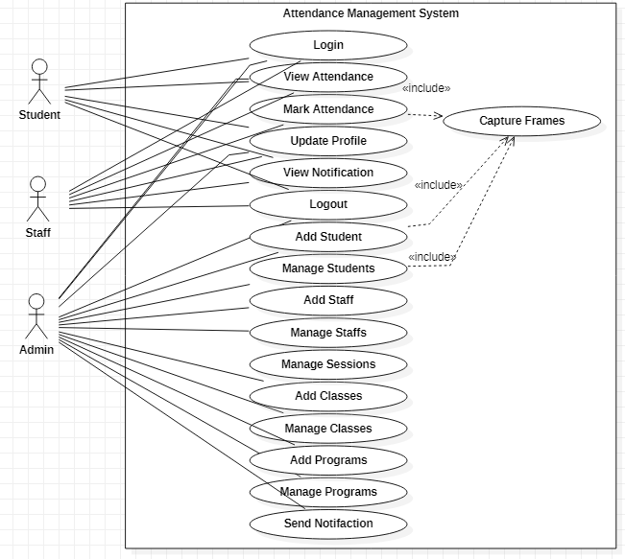
Use Case Diagram

Slide 8
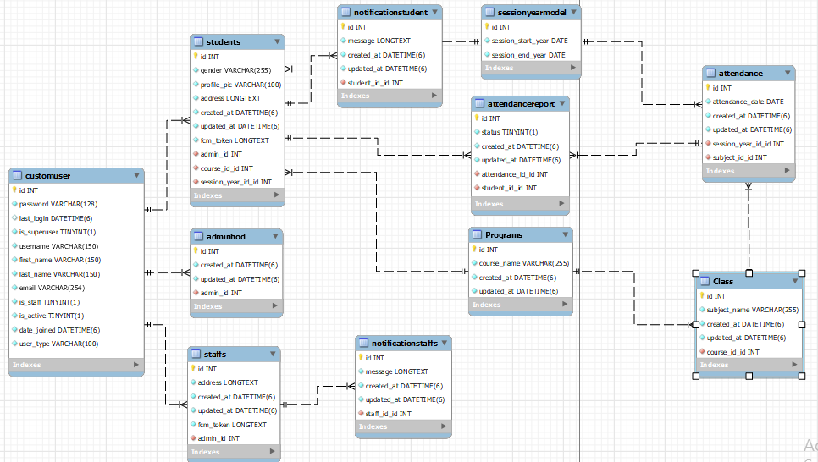
Database Diagram

Slide 9
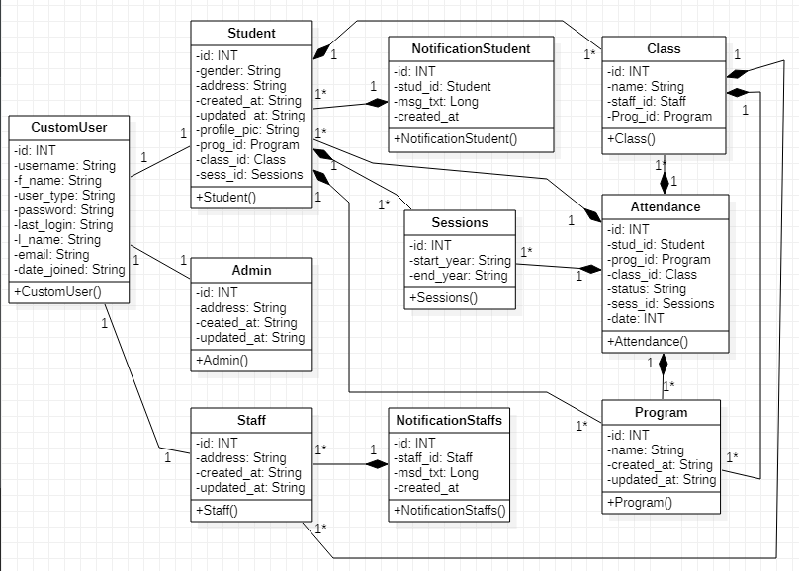
Class Diagram

Slide 10
OpenCV Face Recognition
Local Binary Pattern Histogram (LBPH) Algorithm is used. It is known for its performance and how it is able to recognize the face of a person from both front face and side face.
Overall process consist of 3 parts:
Collecting Datasets (30 frames is captured per person through camera from different angles).
          Training Model (Face acquisition, Feature extraction, Classification)
          Face Recognition

Slide 11
Future Enhancements
Proper Leave Management (Student Will Request leave and staff will approve or reject).
Android/IOS Application.
Email/SMS Push Notification.
Interface for Parents/Guardians.
Time Table Management (Fully Automated).

Slide 12
Thank You

